Slide 1

Encryption Options for MySQL and MongoDB Data at Rest
MSDS 7330 Term Project (08/20/2018)
Shanqing Gu

Slide 2
MSDS 7330 Term Project Outline
Introduction
What is Encryption at Rest?
Why do we need data encrypted?
MySQL
1.1 MySQL Versions
1.2 General Data Encryption Methods in MySQL
1.3 Data Encryption Methods in MySQL Workbench
1.4 Simulation 1: Turn on SSL encryption and test connection between client and server
1.5 Simulation 2: Encrypt individual fields with AES
1.6 Simulation 3: Encrypt individual fields with MD5
MongoDB
2.1 MongoDB Versions
2.2 Data Encryption Methods in MongoDB
2.3 Encryption at Rest in MongoDB Atlas
2.4 Encryption at Rest in MongoDB Community Edition
2.5 Methods for MongoDB individual field encryption
2.6 Simulation for MongoDB individual field encryption
Summary

Slide 3
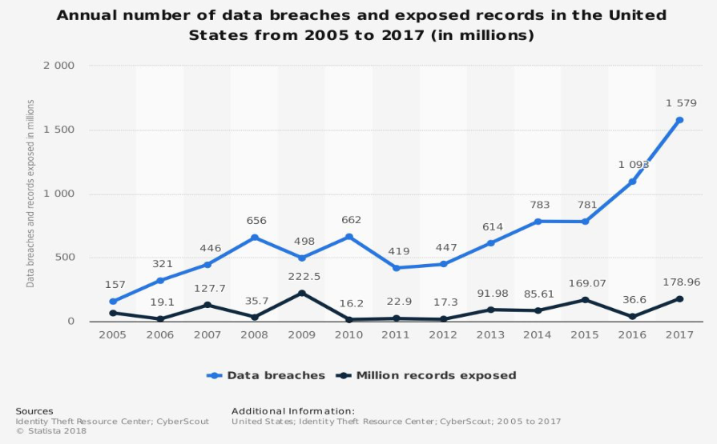
Introduction
1. What is Encryption at Rest?
Data at rest generally refers to the data that is stored in persistent storage (e. g. disk, tape, database, etc.)
Encryption at rest can be achieved at 4 levels (hardware, filesystem, database, or application)
Encryption data on the network is known as “Data-in-Motion Encryption” (e.g. TLS/SSL)
2. Why do we need data encrypted?
Regulatory compliance for handling and storing regulated or sensitive data (e.g. HIPPA, etc.)
Internal compliance policy to protect sensitive data (e. g. SSNs, credit card numbers etc.)
Secure private data (Encryption is hard and often ignored?)
Cyber defense

Slide 4
MySQL
1.1 MySQL Versions
Oracle MySQL Cloud Service (commercial) is built on MySQL Enterprise Edition and powered by Oracle Cloud, providing an enterprise-grade MySQL database service.
MySQL Enterprise Edition (commercial) includes the most comprehensive set of advanced features and management tools for MySQL.
MySQL Cluster CGE (commercial) is a real-time open source transactional database designed for fast, always-on access to data under high throughput conditions.
MySQL Community Edition (GPL) includes Community Server, Cluster, Router, Shell, Workbench, Connectors, on Windows (installer & Tools), Yum Repository, APT Repository, SUE Repository)

Slide 5
1.2 General Data Encryption Methods in MySQL
Full-disk encryption method (weakest)
Application level encryption method (best but not always possible to change the application code)
Database-level (table) encryption (valuable alternative and commonly used for MySQL Community Edition
1.3 Data Encryption Methods in MySQL Workbench
Turn on SSL encryption and test connection between client and server. This SSL encryption needs to set up the paths to Client key file, Client Certificate file, and Certificate Authority file to SSL.
Use the previously installed EcommerceDB in MySQL Workbench, encrypt specifically the CardNumber fields with table space encryption functions (i.e. AES_DECRYPT, MD5, etc.)

Slide 6
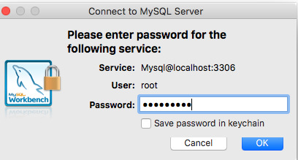
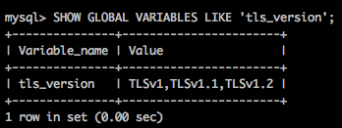
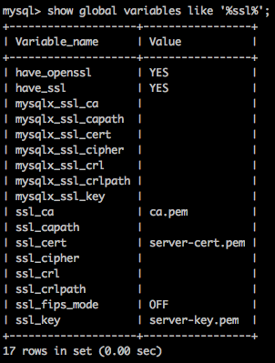
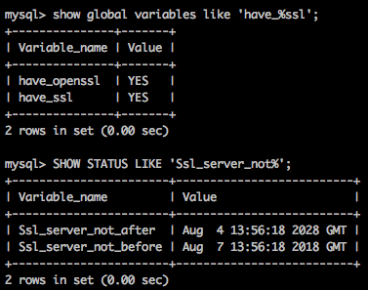
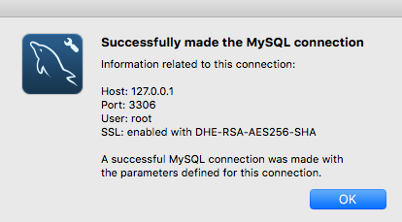
1.4 Simulation 1: Turn on SSL encryption and test connection between client and server
ssl_ca: Path to Certificate Authority file for SSL.
ssl_cert: Path to Client Certificate file for SSL.
ssl_key: Path to Client Key file for SSL

Slide 7
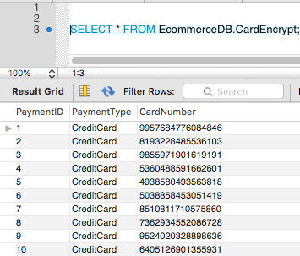
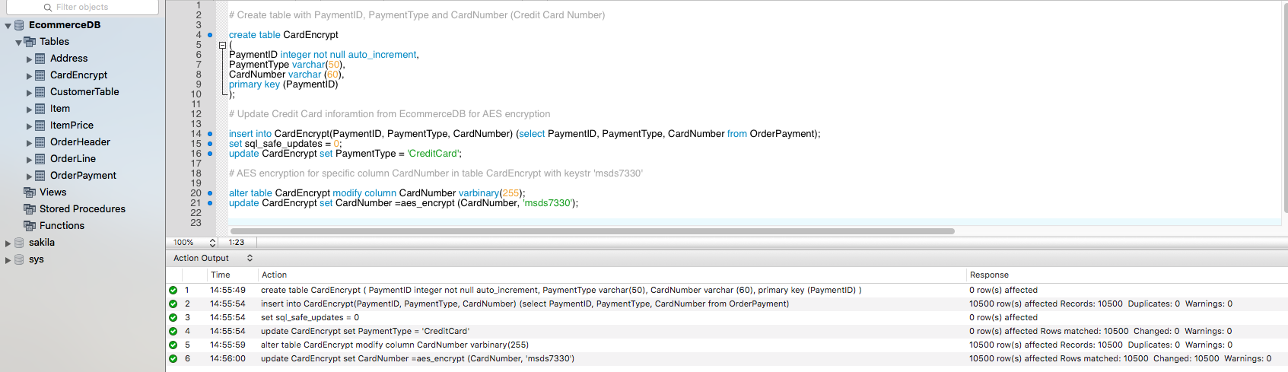
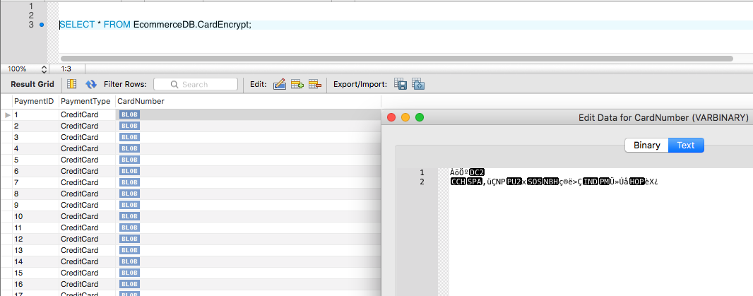
1.5 Simulation 2: Encrypt Credit Card Number with AES

Slide 8
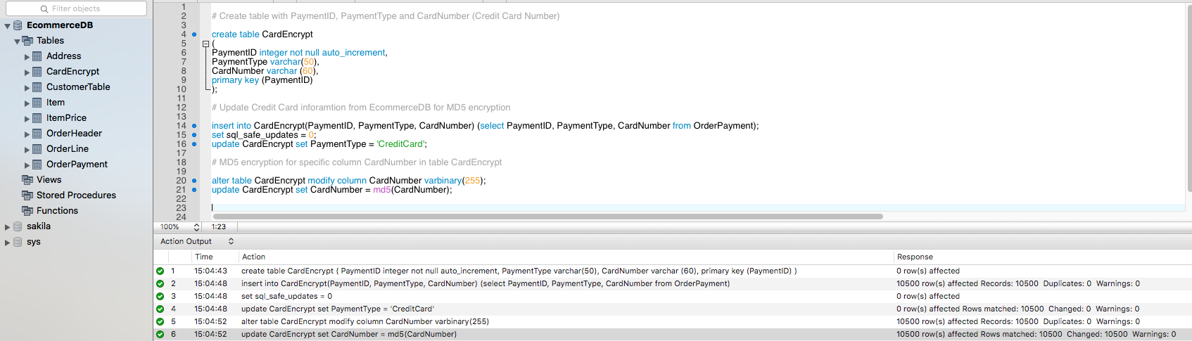
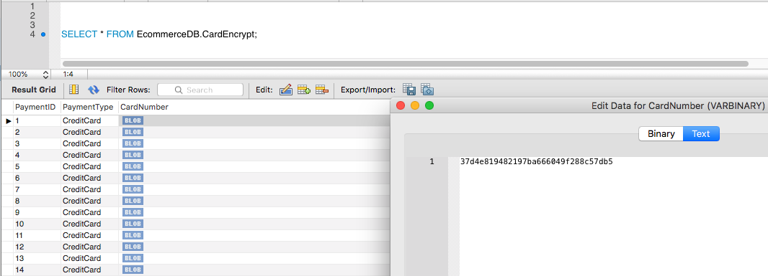
1.6 Simulation 3: Encrypt Credit Card Number with MD5

Slide 9
MongoDB
2.1 MongoDB Versions
MongoDB Atlas is to deploy, operate and scale a MongoDB in the cloud
MongoDB Community Server (current stable release 4.0.1)
MongoDB Enterprise Server includes in-memory and encrypted storage engine and advance security
MongoDB Ops Manager is to monitor, automate, backup and query optimization in data center
MongoDB Compass as the GUI for MongoDB allows to querying, indexing, document validation and so on
MongoDB Connector for BI allows to use BI tool of choice to visualize, discover and report
MongoDB Charts creates visualization of MongoDB data

Slide 10
2.2 Data Encryption Methods in MongoDB
MongoDB Enterprise Server secures data with LDAP and Kerberos access controls.
MongoDB Community Edition has two main authentication methods (Scram-SHA-1 and X.509 Certificate Authentication) and encrypt transaction between client and server using TLS/SSL.
MongoDB Compass has authentication (Username/Password, Kerberos, LDAP or X.509) and SSL encryption.
MongoDB Atlas provides the AWS KMS encryption key details with the WiredTigerTM Encrypted Storage Engine
Two levels of Encryption at Rest:
Storage engine encryption:
Native encryption option for the WiredTiger storage engine only
AES256-CBC via OpenSSL (https://www.openssl.org)
AES-256 uses a symmetric key; i.e. the same key to encrypt and decrypt text
Application level encryption:
Selectively encrypt only required fields in application
Advantages: only readable by the application, low resource cost, and offload encryption overhead from database

Slide 11
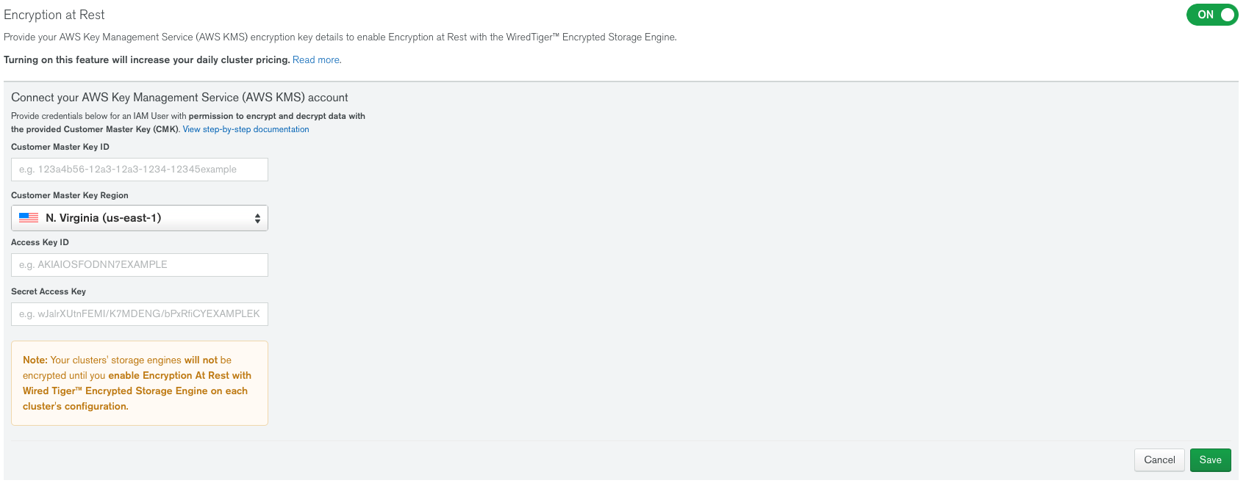
2.3 Enable Encryption at Rest in MongoDB Atlas
MongoDB Atlas provides the AWS KMS encryption key details with the WiredTigerTM Encrypted Storage Engine, supports encryption via customer KMS and LDAP User Authentication and Authorization in Atlas projects and clusters.
To Enable Encryption at Rest for a Project
Log into Atlas.
Select a project from the Context menu.
Click Security, then Enterprise Security.4
Toggle the button next to Encryption at Rest to On.5
Enter your AWS customer master key ID in Customer Master Key ID.6
Select the AWS region where you created AWS CMK from Customer Master Key Region
Enter your IAM user’s access key ID in Access Key ID.8
Enter your IAM user’s secret access key in Secret Access Key.9
Click Save.

Slide 12
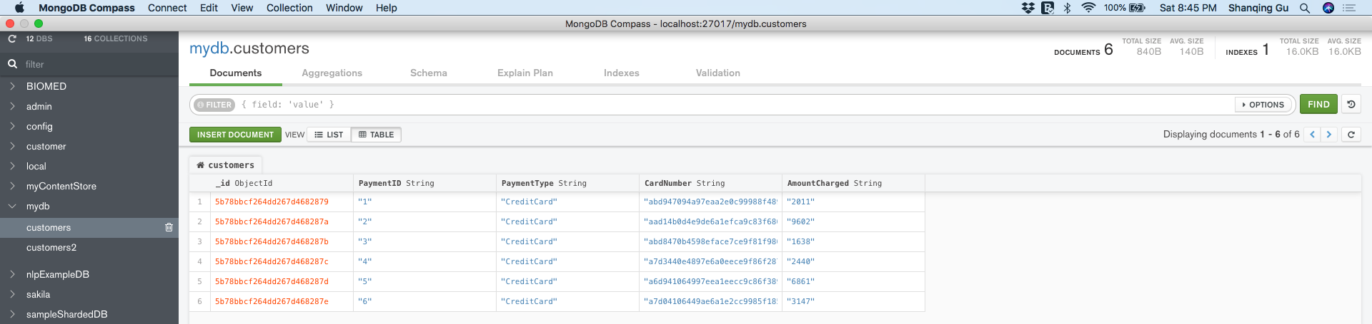
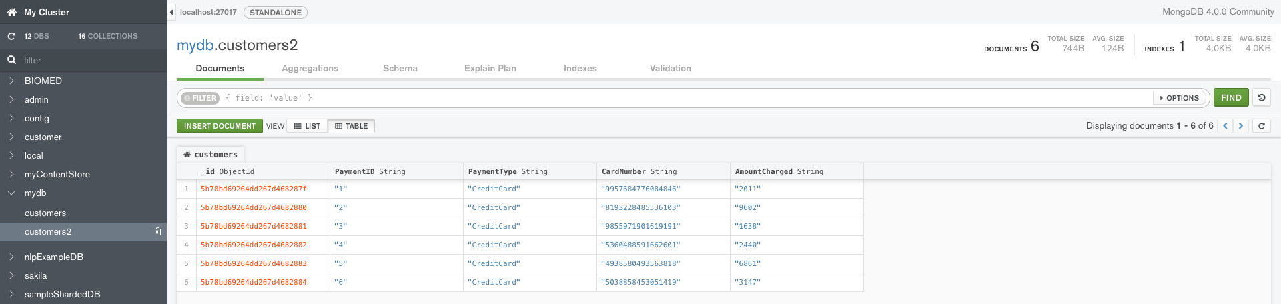
2.4 Encryption at Rest in MongoDB Community Edition

Slide 13
2.5 Methods for MongoDB individual field encryption
eCrptFS (http://ecryptfs.org) is used by Percona to encrypt MongoDB Data at Rest (https://www.percona.com/blog/2018/04/02/mongodb-data-at-rest-encryption-using-ecryptfs/)
Mongoose.js (https://www.npmjs.com/package/mongoose) uses AES-256-CTR to encrypt individual fields (https://www.npmjs.com/package/mongoose-field-encryption)
Use Node.js Crypto Module and MongoDB Node.js Driver to encrypt individual fields
Node.js Crypto is one built-in module in Node.js (https://nodejs.org) to handle OpenSSL cryptographic functions
NPM (https://www.npmjs.com) is the pre-installed package manager for the Node.js server platform
Use MongoDB with Node.js (http://mongodb.github.io/node-mongodb-native/3.1/)

Slide 14
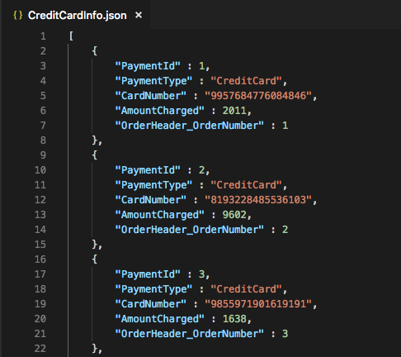
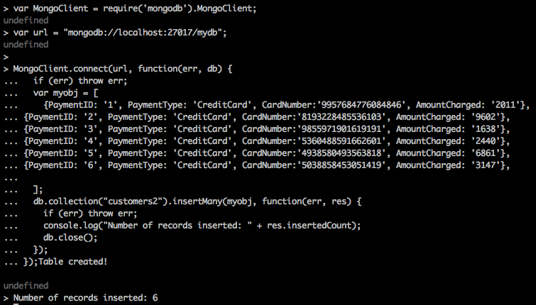
2.6 Simulation for MongoDB individual field encryption
Json Data MongoDB Node.js Driver

Slide 15
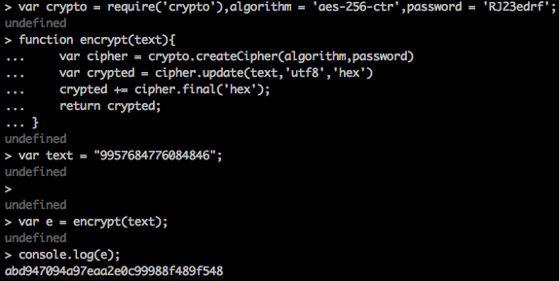
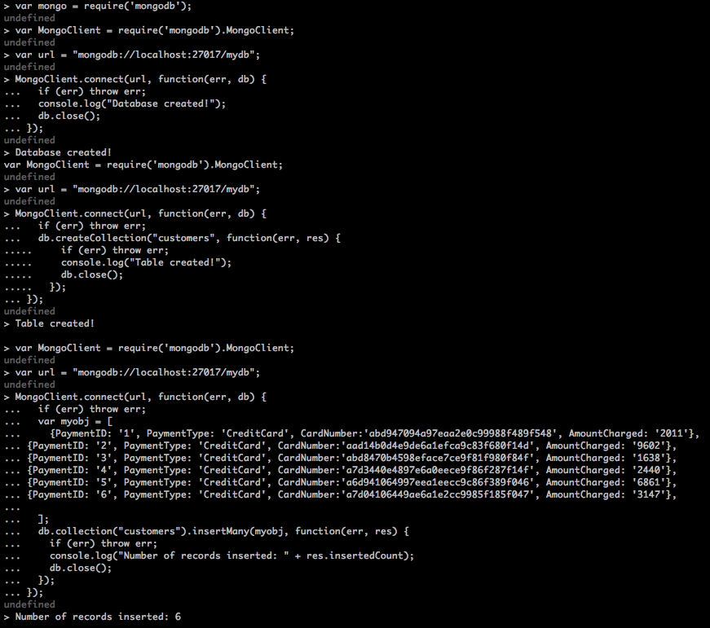
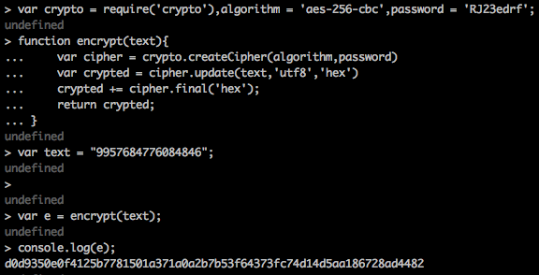
2.6 Simulation for MongoDB individual field encryption
MongoDB Node.js Driver
aes-256-ctr
aes-256-cbc

Slide 16
Summary
MySQL and MongoDB use different strategies for data encryption at rest
Enterprise MySQL and MongoDB provide encryption resource services (but with cost)
Individual field encryption in MySQL GPL Workbench is easier than in MongoDB Community Edition
Acknowledgements
Raghuram Srinivas and all classmates in MSDS 7330 File Organization and Database Management 401

